Slide 1

Weather Application Project
Submitted By:- Vivek Agrawal
Submitted To:- Mr. Pankaj Kapoor
Technical Trainer
Department of Computer Science Engineering & Applications

Slide 2
Weather Application Website
Weather Application is a weather information website which helps in viewing the current weather of the current location. It is a website which shows only the current temperature and condition of the current location.

Slide 3
The purpose to make this project is to provide a platform where any one can check what is the temperature today of the location.
As we know there are many sites available to give such type of information about temperature but we will provide a quick link to check the temperature and type of weather also there.
This will reduce the time of the user because now to watch a temperature or a type we have to search lot. And no platforms are available to tell about the temperature of the location.

Slide 4
Code:- index.html
<!DOCTYPE html>
<html lang="en">
<head>
<meta charset="UTF-8">
<title>Weather App - JavaScript</title>
<link rel="stylesheet" href="font/rimouski.css">
<link rel="stylesheet" href="style.css">
</head>
<body>
<div class="container">
<div class="app-title">
<p>Weather</p>
</div>
<div class="notification"> </div>
<div class="weather-container">

Slide 5
<div class="weather-icon">
<img src="./img/01d.png" alt="">
<img src="./img/01n.png" alt="">
<img src="./img/02d.png" alt="">
<img src="./img/02n.png" alt="">
<img src="./img/03d.png" alt="">
<img src="./img/03n.png" alt="">
<img src="./img/04d.png" alt="">
<img src="./img/04n.png" alt="">
<img src="./img/09d.png" alt="">
<img src="./img/09n.png" alt="">
<img src="./img/10d.png" alt="">
<img src="./img/10n.png" alt="">
<img src="./img/11d.png" alt="">
<img src="./img/11n.png" alt="">
<img src="./img/13d.png" alt="">
<img src="./img/13n.png" alt="">
<img src="./img/50d.png" alt="">
<img src="./img/50n.png" alt="">
<img src="./img/unknown.png" alt="">
</div>

Slide 6
<div class="temperature-value">
<p>- °<span>C</span></p>
</div>
<div class="temperature-description">
<p> - </p>
</div>
<div class="location">
<p>-</p>
</div>
</div>
</div>
<script src="app.js"></script>
</body>
</html>

Slide 7
Code:- style.css
*{
font-family: "Rimouski";
}
body{
background-color: #293251;
}
.container{
width: 300px;
background-color: #FFF;
display: block;
margin: 0 auto;
border-radius: 10px;
padding-bottom : 50px;
}
.app-title{
width: 300px;
height: 50px;
border-radius: 10px 10px 0 0;
}
.app-title p{
text-align: center;
padding: 15px;
margin: 0 auto;
font-size: 1.2em;
color: #293251;
}
.notification{
background-color: #f8d7da;
display: none;
}

Slide 8
.notification p{
color: #721c24;
font-size: 1.2em;
margin: 0;
text-align: center;
padding: 10px 0;
}
.weather-container{
width: 300px;
height: 260px;
background-color: #F4F9FF;
}
.weather-icon{
width: 300px;
height: 128px;
}
.weather-icon img{
display: block;
margin: 0 auto;
}
.temperature-value{
width: 300px;
height:60px;
}
.temperature-value p{
padding: 0;
margin: 0;
color: #293251;
font-size: 4em;
text-align: center;
cursor: pointer;
}

Slide 9
.temperature-value p:hover{
}
.temperature-value span{
color: #293251;
font-size: 0.5em;
}
.temperature-description{
}
.temperature-description p{
padding: 8px;
margin: 0;
color: #293251;
text-align: center;
font-size: 1.2em;
}
.location{
}
.location p{
margin: 0;
padding: 0;
color: #293251;
text-align: center;
font-size: 0.8em;
}

Slide 10
Code:- app.js
const iconElement = document.querySelector(".weather-icon");
const tempElement = document.querySelector(".temperature-value p");
const descElement = document.querySelector(".temperature-description p");
const locationElement = document.querySelector(".location p");
const notificationElement = document.querySelector(".notification");
// OUR APPLICATION DATA
const weather = {};
weather.temperature = {
unit : "celsius"
};
// APP CONSTANTS AND VARS
const KELVIN = 273;
// API KEY
const key = "82005d27a116c2880c8f0fcb866998a0";
// CHECK IF BROWSER SUPPORT GEOLOCATION and GET LOCATION
if("geolocation" in navigator){
navigator.geolocation.getCurrentPosition(setPosition, showError);
}else{
notificationElement.style.display = "block";
notificationElement.innerHTML = "<p>Browser Doesn't Support Geolocation.</p>";
}
// SET POSITION
function setPosition(position){
console.log(position);
let latitude = position.coords.latitude;
let longitude = position.coords.longitude;
getWeather(latitude, longitude);
}
// GET WEATHER FROM API

Slide 11
function getWeather(latitude, longitude){
let api = `http://api.openweathermap.org/data/2.5/weather?lat=${latitude}&lon=${longitude}&appid=${key}`;
fetch(api)
.then(function(response){
let data = response.json();
return data;
}).then(function(data){
weather.temperature.value = Math.floor(data.main.temp - KELVIN); // Celsius
weather.description = data.weather[0].description;
weather.iconId = data.weather[0].icon;
weather.city = data.name;
weather.country = data.sys.country;
}).then(function(){
displayWeather();
});
}
// SHOW ERROR
function showError(error) {
notificationElement.style.display = "block";
notificationElement.innerHTML = `<p> ${error.message} </p>`;
}

Slide 12
// toggle fahrenheit ans celcius
tempElement.addEventListener("click", function(){
if(weather.temperature.value === undefined) return;
if(weather.temperature.unit === "celsius"){
let fahrenheit = celsiusToFahrenheit(weather.temperature.value);
fahrenheit = Math.floor(fahrenheit);
tempElement.innerHTML = `${fahrenheit}° <span>F</span>`;
weather.temperature.unit = "fahrenheit"
}else{
tempElement.innerHTML = `${weather.temperature.value}° <span>F</span>`;
weather.temperature.unit = "celsius"
}
});
// display weather info to ui
function displayWeather(){
iconElement.innerHTML = `<img src="icons/${weather.iconId}.png"/>`;
tempElement.innerHTML = `${weather.temperature.value}° <span>C</span>`;
descElement.innerHTML = weather.description;
locationElement.innerHTML = `${weather.city}, ${weather.country}`;
}
// °C to °F conversion
function celsiusToFahrenheit(temperature){
// (0 °C × 9/5) + 32 = 32 °F
return (temperature * 9/5) + 32;
}

Slide 13
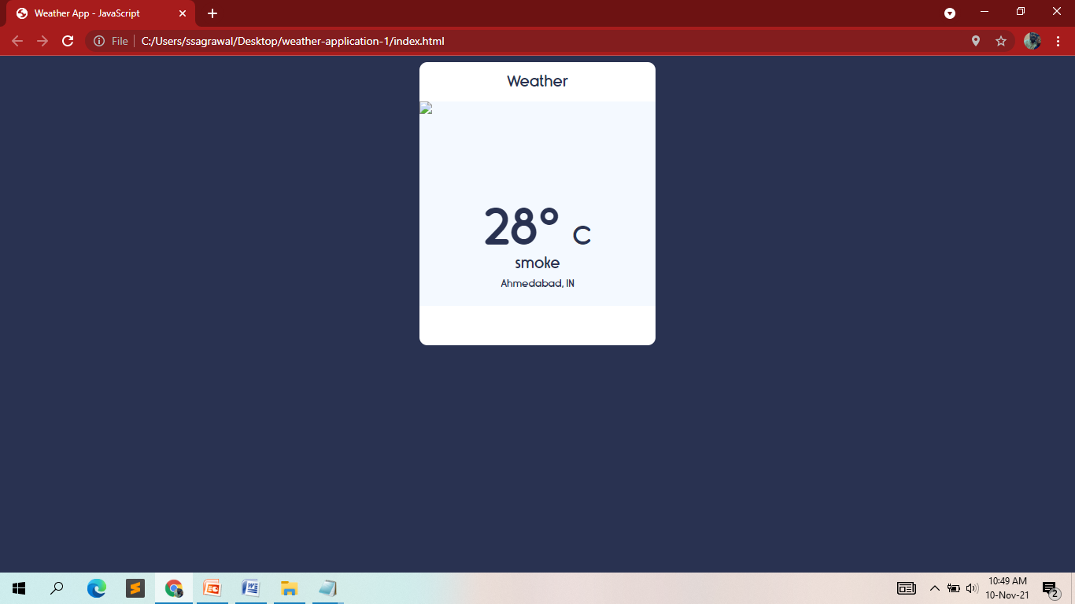
Output

Slide 14
Thank You

